Slide 1
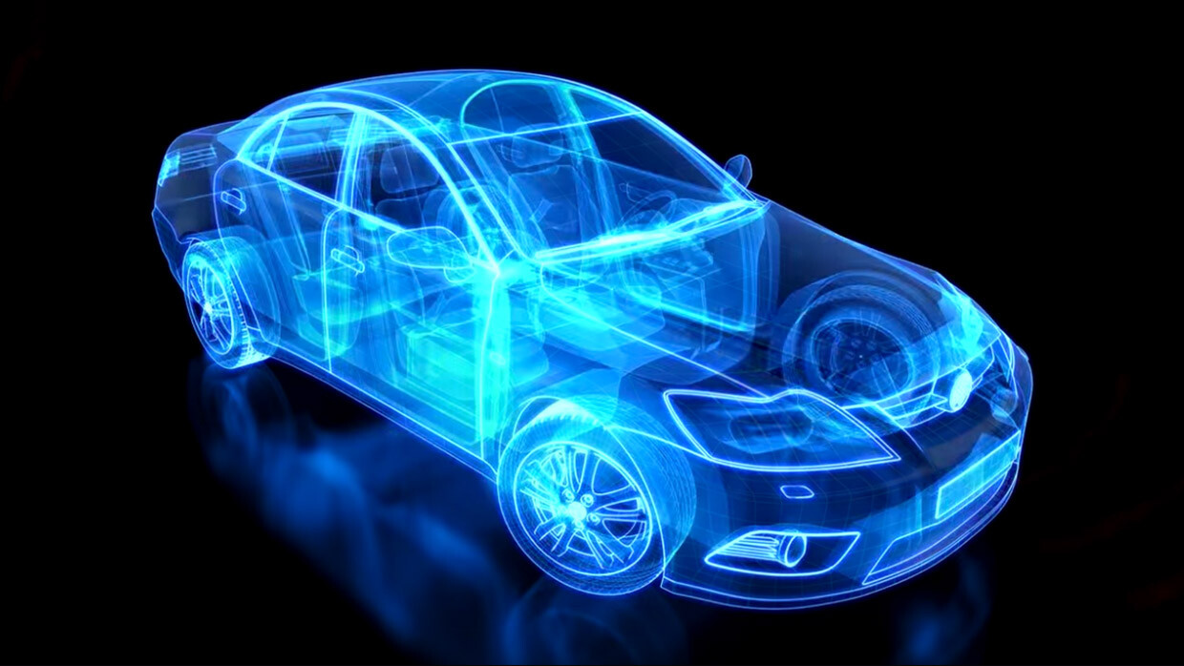

ANALYZING THE IMPACT OF CAR FEATURES ON PRICE AND PROFITABILITY
By, Shngain Kupar Shullai

Slide 2
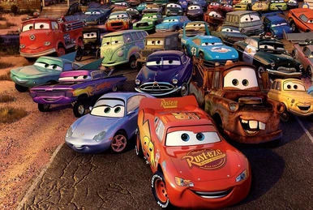
PROJECT DESCRIPTION
This project aims to help car manufacturers optimize pricing and product development decisions to maximize profitability by analyzing the relationship between car features, market categories, and pricing.
"How can a car manufacturer optimize pricing and product development to maximize profitability while meeting consumer demand?“
This data source for the project is a CSV file titled "Car Features and MSRP," provided by Cooper Union on Kaggle, containing detailed specifications and prices of various car models. Data cleaning and preprocessing involved removing duplicates, handling missing values, and converting variables into suitable formats for analysis. Assuming that consumer preferences for car features have remained consistent since the last dataset update in 2017.
Excel File Click Here

Slide 3
Cleaning
Involves removing errors, inconsistencies, and duplicates, ensuring accurate and reliable data for analysis.
Approach
Understanding
Involves extracting meaningful insights and patterns from raw information.
Analysis
Involves uncovering insights and patterns within datasets
Visualization
Insightful representations of complex data, enhancing understanding through intuitive l presentations.

Slide 4



Click Here for the Excel File
Tech-Stack Used
Filters, Cleaning, Analysis, Dashboard, etc..
Project Presentation

Slide 5
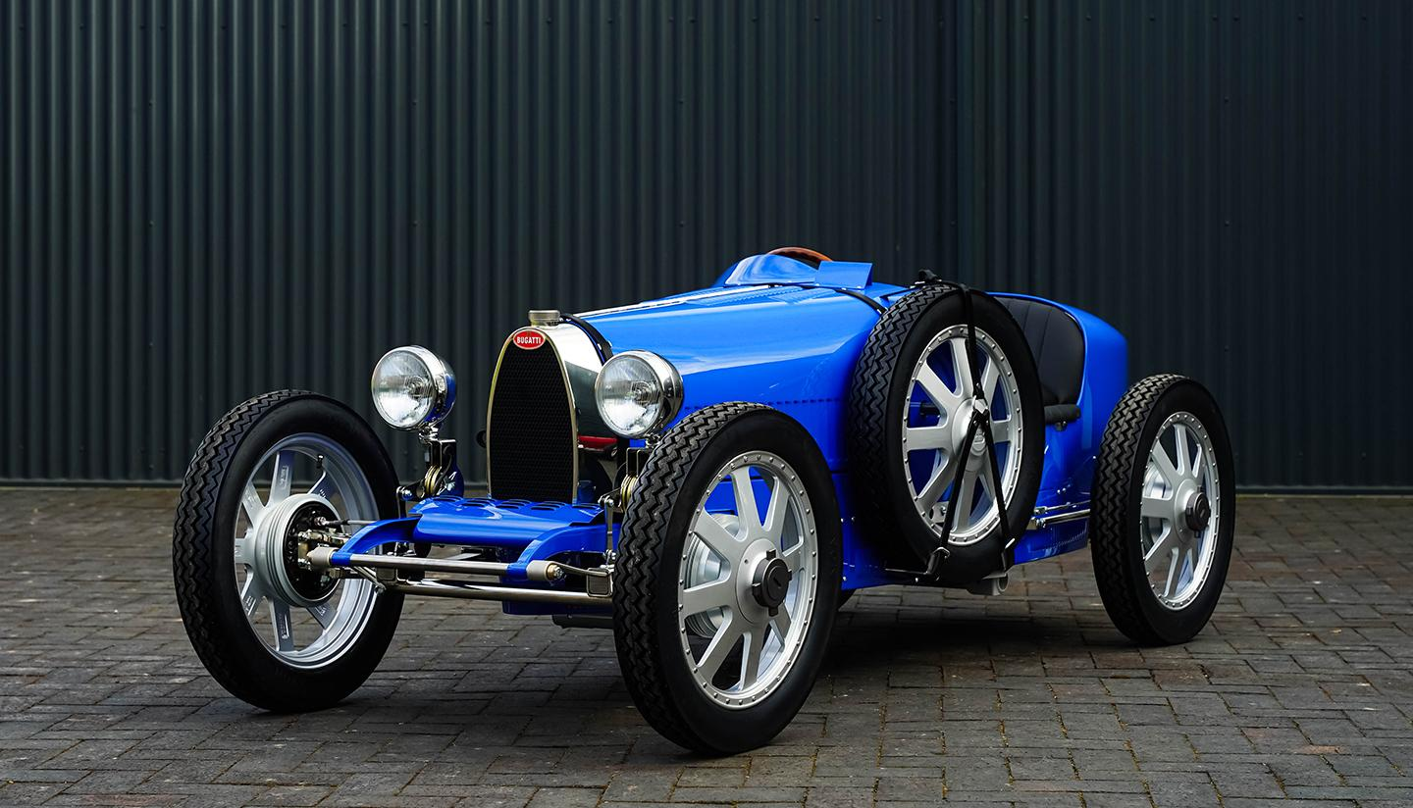
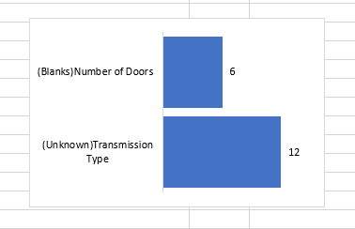
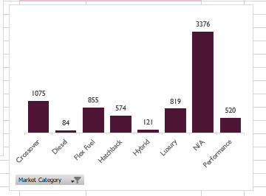
Data Understanding
No. of Variables = 16
No. of Rows = 11199
No. of Rare Data points = Market Category = 3376
No. of blanks = Number of Doors = 6
No. of UNKNOWN = Transmission Type =12

Slide 6
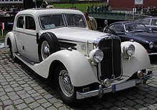
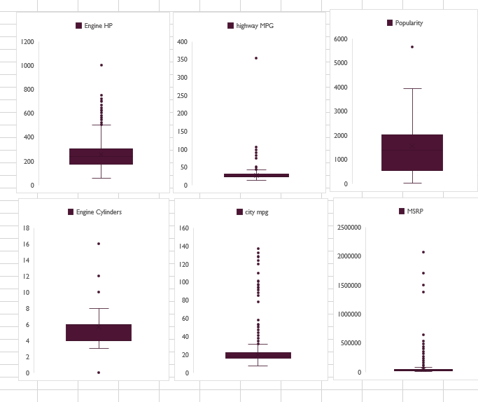
Outliers
I remove outlier from Highway MPG which is 354 and replaced it with 34 being the closest similar value of Audi A6 taking the same popularity(3105) and same City MPG(24).
Real outliers in
Popularity of 5657 : 825 entries of Ford
Engine HP of 1001 : Bugatti
Engine Cylinders : Bugatti
City MPG : EV : BMW and Honda
MSRP : Bugatti, Maybach and Lamborghini
that cannot be removed, such as the high frequency of 825 entries for Ford, represent genuine variations in the dataset that reflect significant market realities and should be retained for accurate analysis.

Slide 7
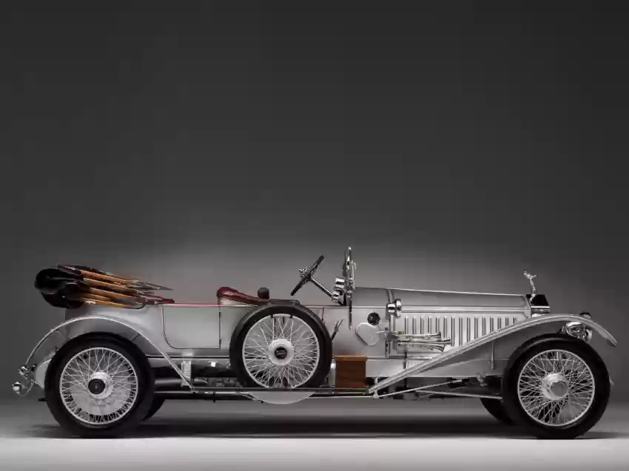
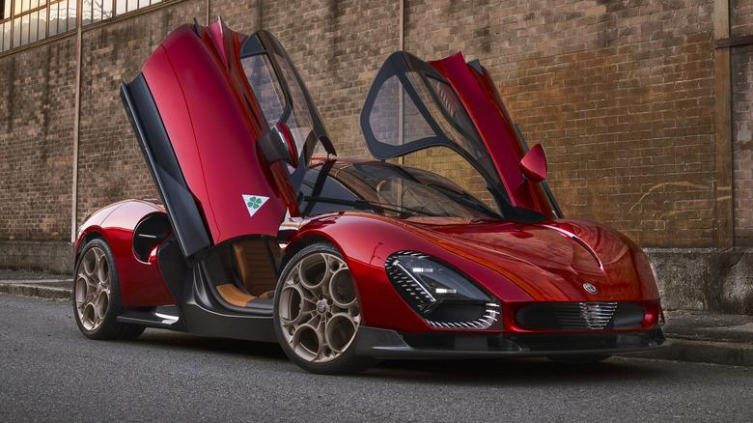
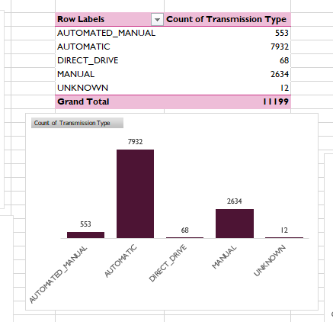
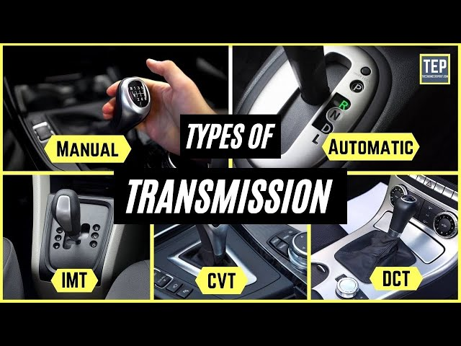
Cleaning
>>> 1 no. of missing doors data of Ferrari FF is enter with 2 doors because as of now the company has not produced any 4-doors models.
>>> 5 nos. of Tesla Model S typically has 4 doors.
12 nos. of ‘UNKNOWN’ were imputed by ‘AUTOMATIC’ taking the mode value using the Pivot Chart.
3376 nos. of N/A in Market Category were left unchanged due to their significant volume.

Slide 8
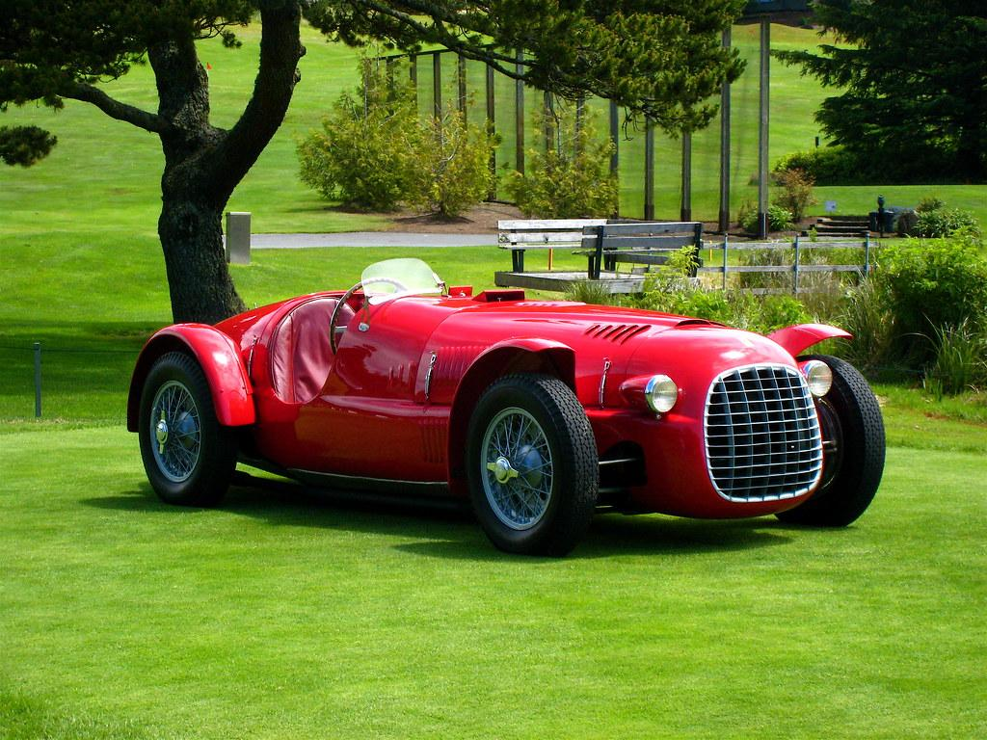
Tasks: Analysis
How does the popularity of a
car model vary across different
market categories?

Slide 9
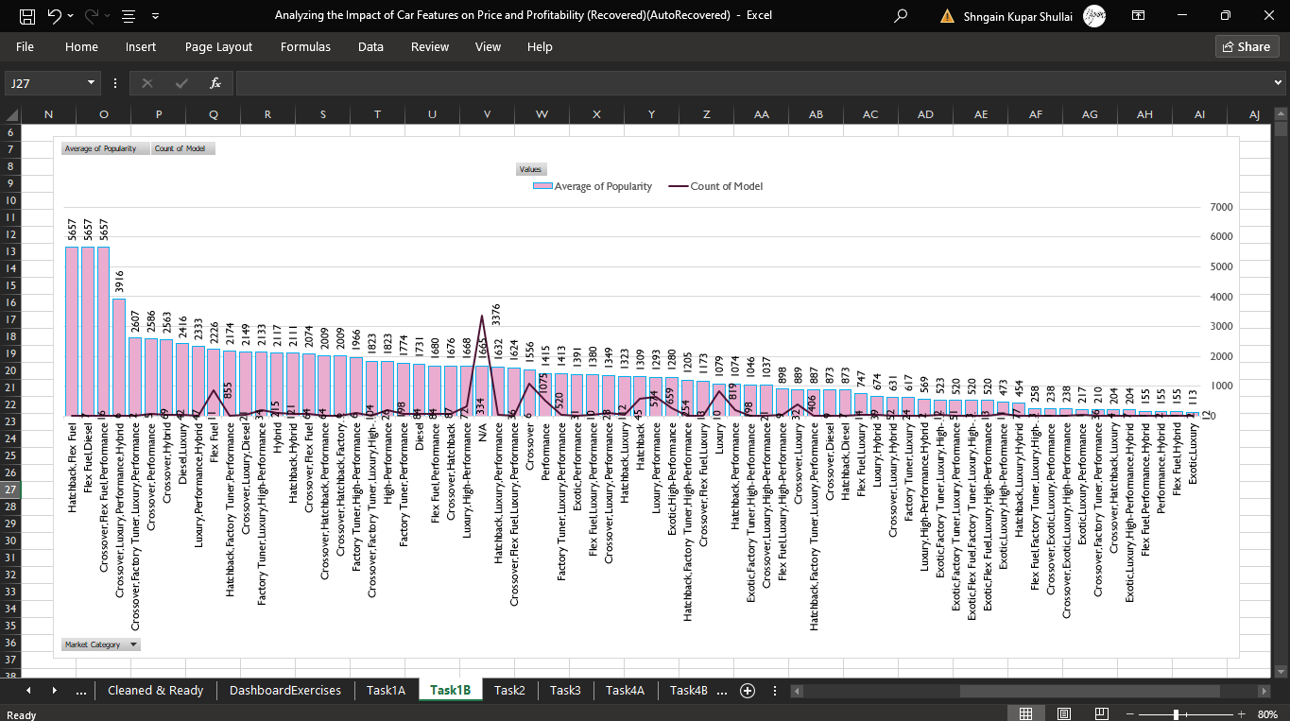
Task1B: A pivot chart that shows the number of car models in each market category and their corresponding popularity scores.
The categories "Hatchback, Flex Fuel," "Crossover, Flex Fuel, Performance," and "Flex Fuel, Diesel" each have an exceptionally high average popularity of 5657, indicating these specific combinations are highly favored among consumers.

Slide 10
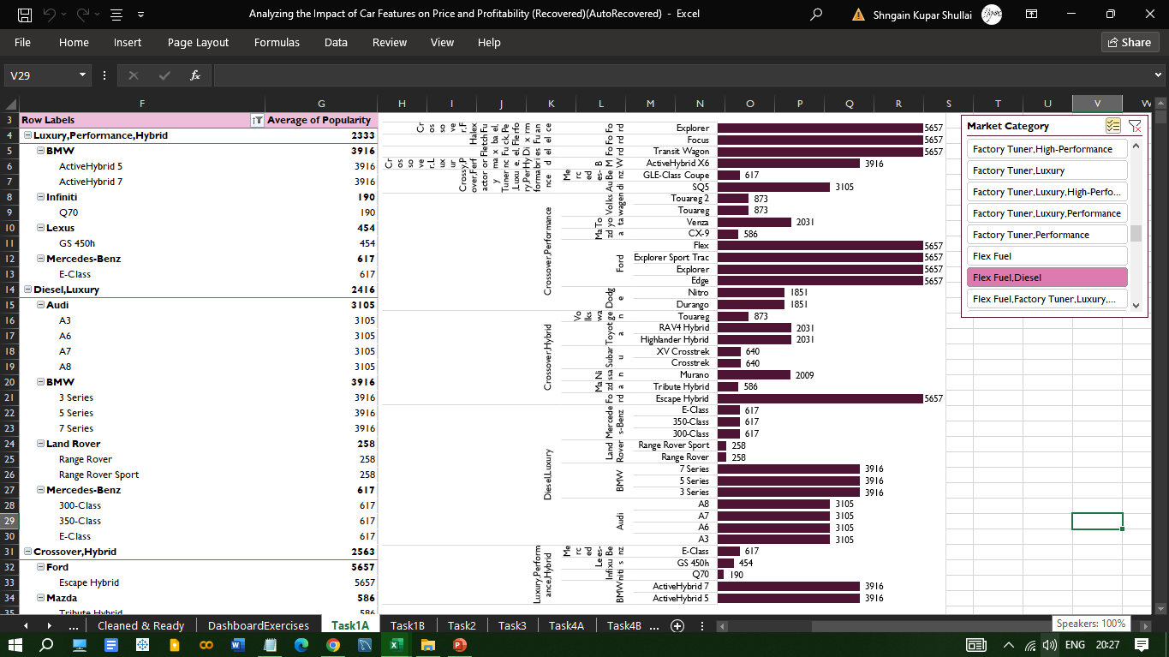
Task1A
A pivot table that shows the number of car models in market category and their corresponding popularity scores.
1.Hatchback, Flex Fuel 2.Flex Fuel, Diesel
3.Crossover, Flex Fuel, Performance
4.Crossover, Luxury, Performance, Hybrid
5.Crossover, Factory Tuner, Luxury, Performance
6.Crossover, Performance 7.Crossover, Hybrid
8.Diesel, Luxury 9.Luxury, Performance, Hybrid
The data highlights BMW and Ford as leaders in their respective categories,
with consistently high scores indicating strong market acceptance and brand loyalty.
Audi also performs well, particularly in the luxury segment.
This uniform score suggests these models are
either highly favored or represent a common
benchmark in the data set.

Slide 11
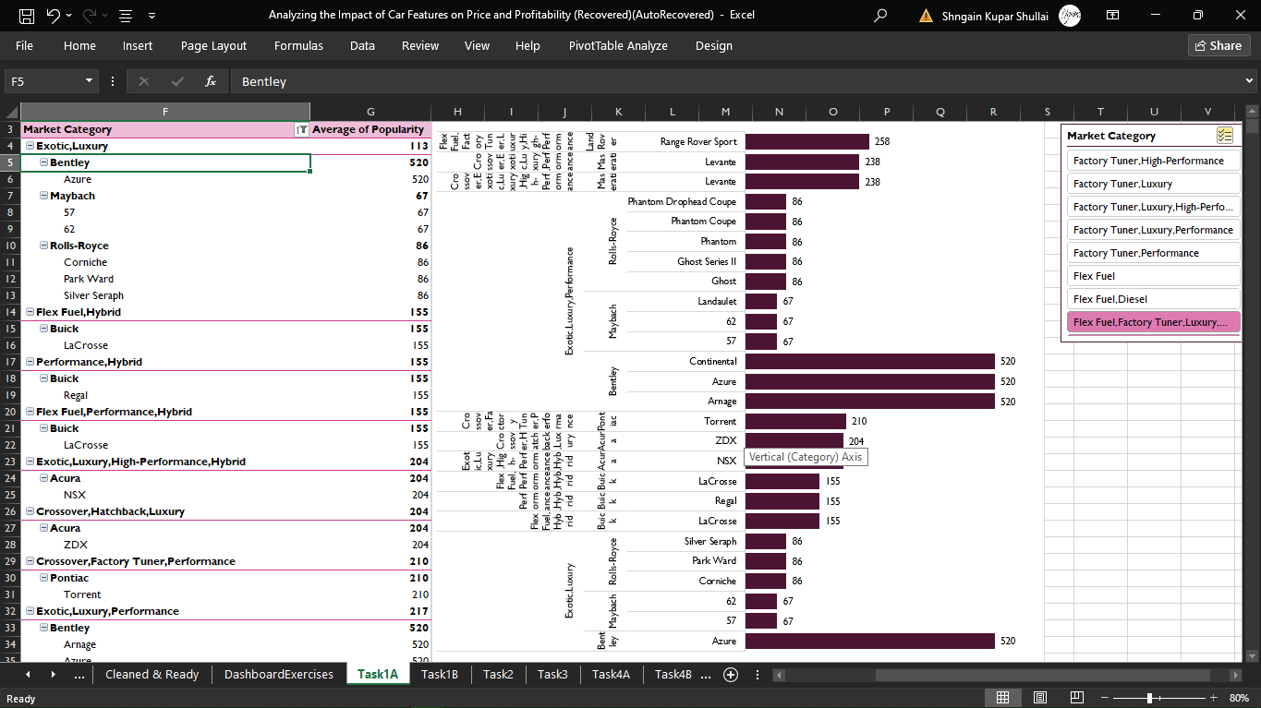
Task1A
A pivot table that shows the number of car models in market category and their corresponding popularity scores.
(Exotic,Luxury,High-Performance),(Hatchback,Luxury,Hybrid)
(Flex Fuel,Factory Tuner,Luxury,High-Performance)
(Crossover,Exotic,Luxury,Performance),(Crossover,Exotic,Luxury,High-Performance)
(Exotic,Luxury,Performance)(Crossover,Factory Tuner,Performance)
(Crossover,Hatchback,Luxury)(Exotic,Luxury,High-Performance,Hybrid)
(Flex Fuel,Performance,Hybrid)(Performance,Hybrid)
(Flex Fuel,Hybrid)(Exotic,Luxury)
Even though with lower popularity scores 520, exotic and luxury cars like Bentley, Maybach, and Rolls-Royce maintain a niche but dedicated following due to their exclusivity and status symbols.
Additionally, the presence of hybrid and
high-performance vehicles within luxury brands
such as Acura and Maserati indicates a growing
market interest in combining luxury with
sustainability and performance.

Slide 12
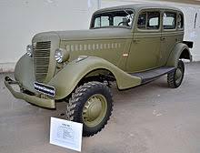
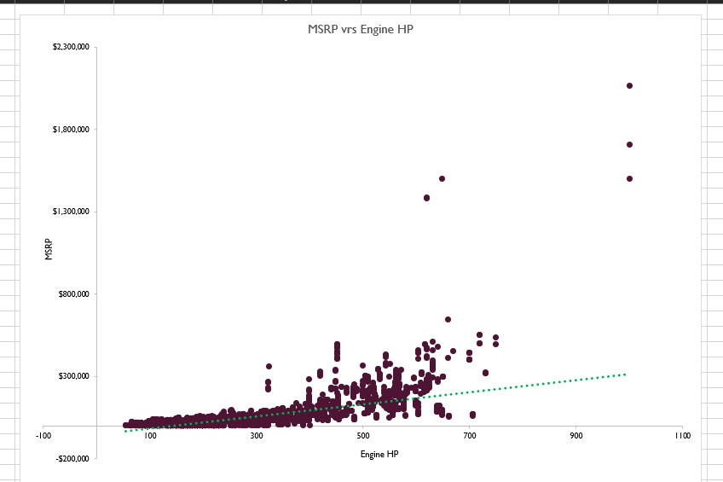
Task2
A scatter chart that plots engine power on the x-axis and price on the y-axis vrs A trendline to visualize the relationship between these variables.
The data shows a trend where higher engine horsepower (HP) generally corresponds to higher prices (MSRP).
Cars with 620 HP are priced between $1,380,000 and $1,382,750.
A car with 650 HP is listed at $1,500,000.
Cars with 1001 HP have a broader price range, from $1,500,000 to $2,065,902.
The trendline suggests that more powerful engines usually lead to higher prices and other factors such as the brand and specific features also play significant roles in determining the final price.

Slide 13
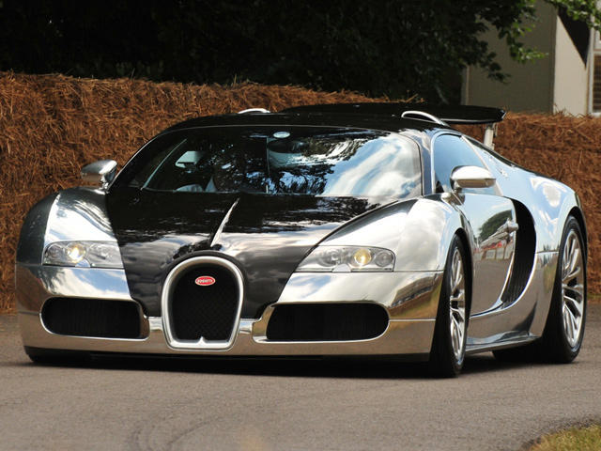
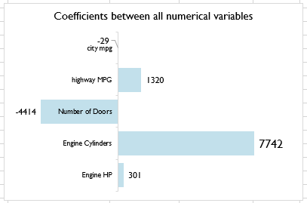
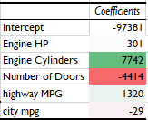
Which car features are most important in determining a car's price?
Task3
More Cylinders and Higher horsepower substantially increases the price, as they are often associated with more powerful and premium vehicles.
To increase a car's market value, manufacturers should focus on enhancing engine power and the number of cylinders.
Better fuel efficiency on highways positively impacts the price, likely due to increased consumer preference for fuel savings in long-distance travel.
Improving highway fuel efficiency can also make a car more attractive to buyers and justify a higher price.
A bar chart showing the coefficient values for each variable to visualize the relative strength of Engine Cylinders variable.
Regression analysis identifying Engine Cylinders having the strongest relationship with a car's price.

Slide 14
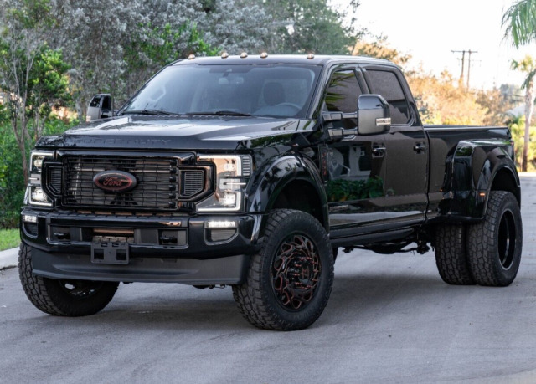
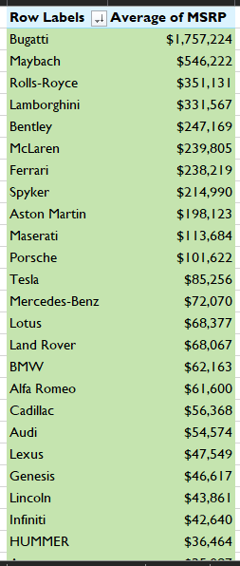
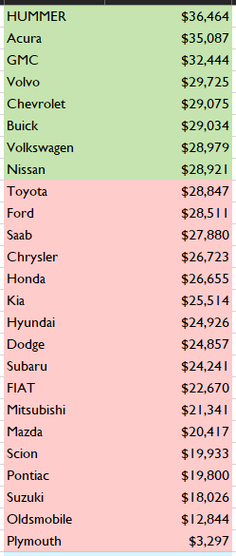
A pivot table that shows the average price of cars for each manufacturer.
Task4A
High average prices are primarily due to their powerful engines, with horsepower ranging from 620 to 1001 HP, which significantly boosts their value.
Additionally, their classification as exotic, high-performance, and luxury vehicles, combined with premium features like automated manual transmissions and premium unleaded fuel requirements, contribute to their elevated market prices.
Lastly, the exclusivity and limited production of models such as the Maybach and Bugatti Veyron further drive up their prices due to high demand among luxury car enthusiasts.
Low average prices because many are older models, which depreciates their value over time.
Additionally, while some models are luxury or performance-oriented, their older manufacturing dates and high mileage can significantly reduce their market value.
However, these vehicles can still offer advantages such as lower purchase costs, potentially lower insurance premiums, and a more affordable entry into luxury or performance categories for budget-conscious buyers.

Slide 15
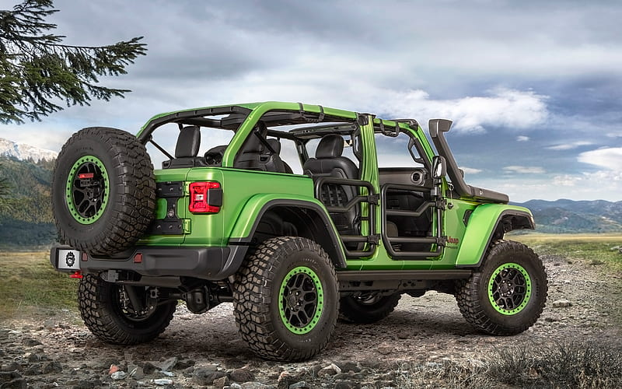
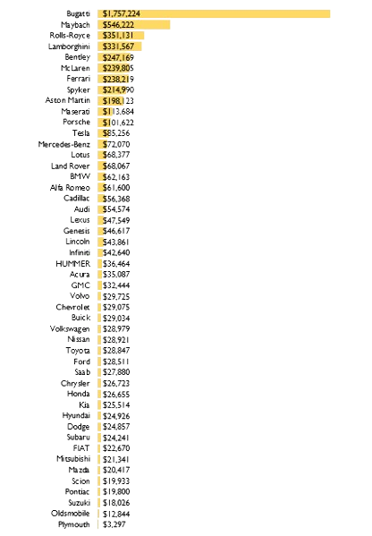
A horizontal stacked bar chart that visualizes the relationship between manufacturer and average price.
Task4B
The significant variation in MSRP among luxury car brands like Bugatti, Maybach, and Rolls-Royce is influenced by factors such as engine horsepower, engine cylinders, and market category, with higher performance and exclusivity driving up prices.
Besides, features like advanced transmission types, driven wheels configurations, and premium vehicle styles contribute to the higher valuation of these luxury cars.
Finally, fuel efficiency (highway and city MPG) and the brand's overall popularity also play crucial roles in determining the market price of these high-end vehicles.

Slide 16
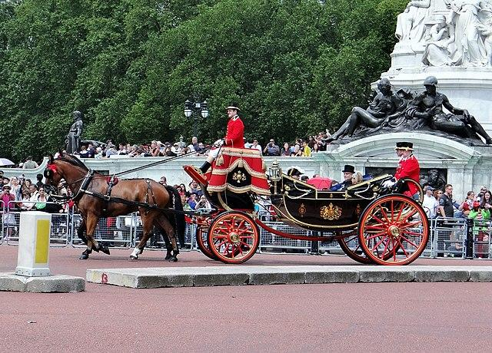
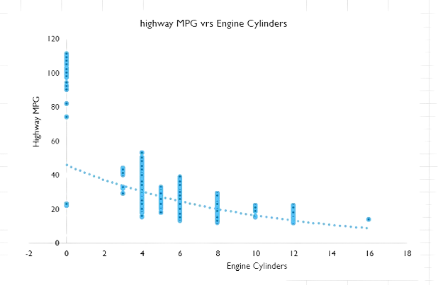
Task5A A scatter plot with the number of cylinders on the x-axis and highway MPG on the y-axis & a trendline on the scatter plot to visually estimate the slope of the relationship and assess its significance.
Chevrolet Spark EV boasts high efficiency, with highway MPG of 109-110 and city MPG of 128-137 reflect the efficiency of electric powertrains in urban and highway driving which prioritize power and performance over fuel economy.
Ferrari 456M and Bugatti Veyron, powerful engines with 12 to 16 cylinders, premium fuel requirements, and MSRPs soaring into the hundreds of thousands and even millions, highlighting their status as luxury, high-performance vehicles with exotic appeal.

Slide 17

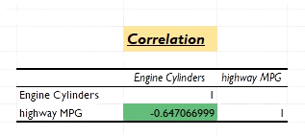
Task5B Correlation coefficient between the number of cylinders and highway MPG to quantify the strength and direction of the relationship.
The negative correlation coefficient of -0.647 between engine cylinders and highway MPG indicates a significant inverse relationship, meaning that as the number of engine cylinders increases, the highway fuel efficiency tends to decrease.
This confirms that vehicles with more cylinders are generally less
fuel-efficient on highways.

Slide 18
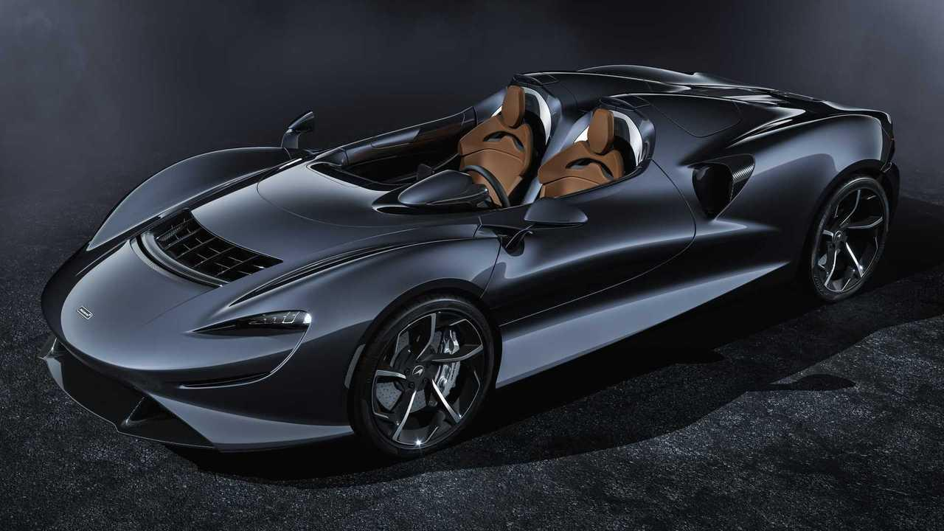
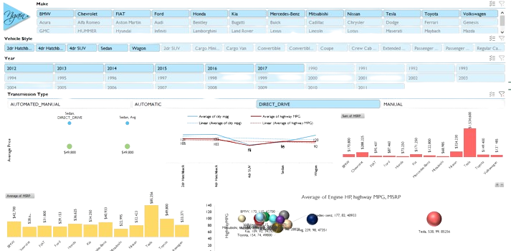
Interactive
The Dashboard
The Dashboard

Slide 19
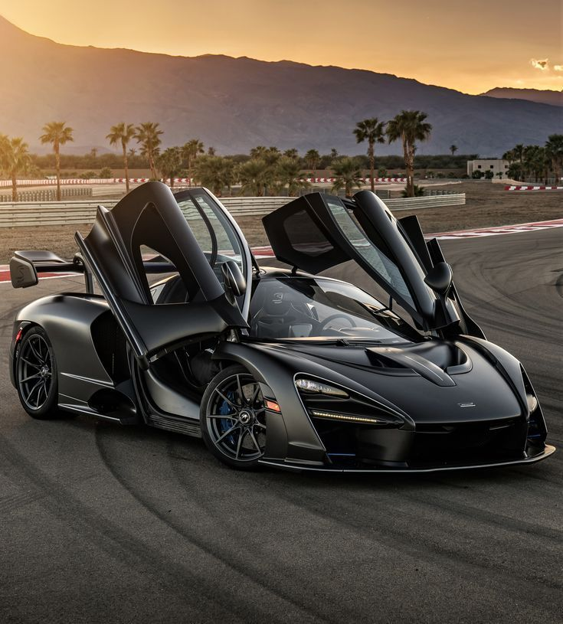
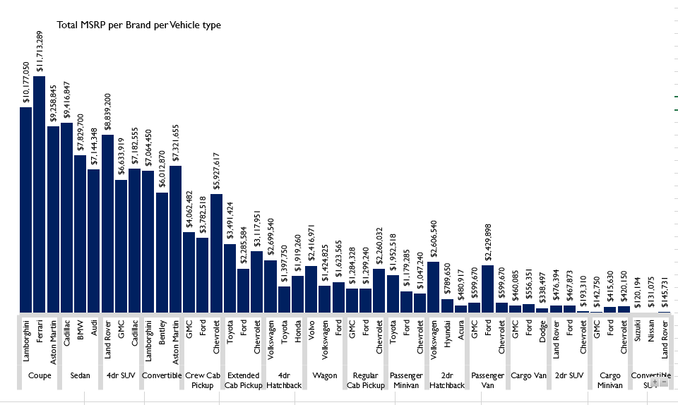
Task1 Stacked column chart showing the Total car prices by brand
with respect to vehicle style using Pivot Tables.
High-end brands like Lamborghini and Ferrari commanding the highest MSRPs for coupes and convertibles, indicating a premium for luxury and performance.
In the sedan category, Cadillac leads with the highest total MSRP, showcasing its strong presence in the luxury sedan market.
For SUVs, Land Rover has the highest total MSRP, highlighting its dominance in the luxury SUV segment.

Slide 20
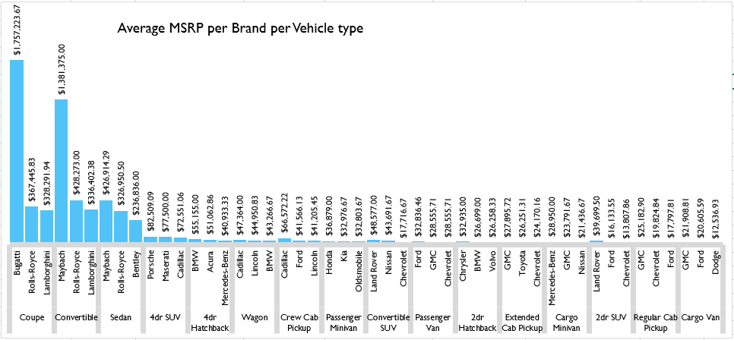
Task2 Stacked column chart showing the Average car prices by brand with respect to vehicle style using Pivot Tables.
Luxury brands like Bugatti, Maybach, and Rolls-Royce commanding the highest prices for coupes, convertibles, and sedans.
In contrast, more practical body styles such as 4-door SUVs, 4-door hatchbacks, and crew cab pickups feature lower average prices, particularly from brands like Porsche, BMW, and Cadillac.
The data highlights a clear price premium for luxury and high-performance brands across different market categories compared to more utilitarian vehicles from mainstream brands.

Slide 21
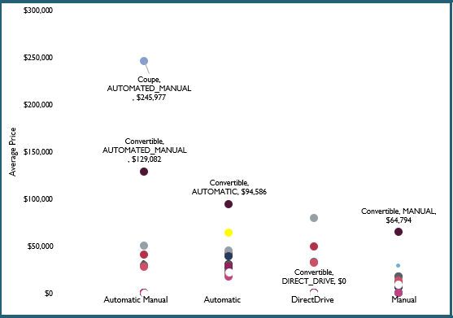
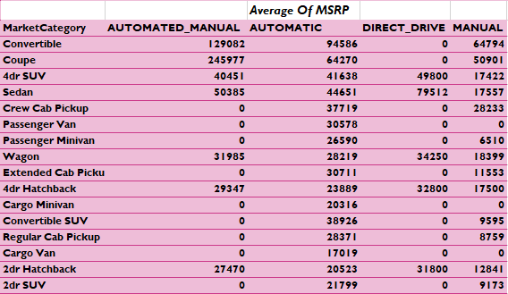
Scatter plot chart visualizing relationship between MSRP and transmission type, with different symbols for each body style.
Task3
Calculation of the average MSRP for each combination of transmission type and body style using Pivot Tables
Automated manual transmissions generally leading to the highest average prices, especially in body styles like coupes ($245,977) and convertibles ($129,082).
Automatic transmissions also result in relatively high prices, particularly for convertibles ($94,586) and sedans ($44,651).
In contrast, manual transmissions tend to have the lowest average MSRPs across most body styles, such as sedans ($17,557), reflecting a preference for automated and automatic transmissions in higher-priced vehicles.

Slide 22
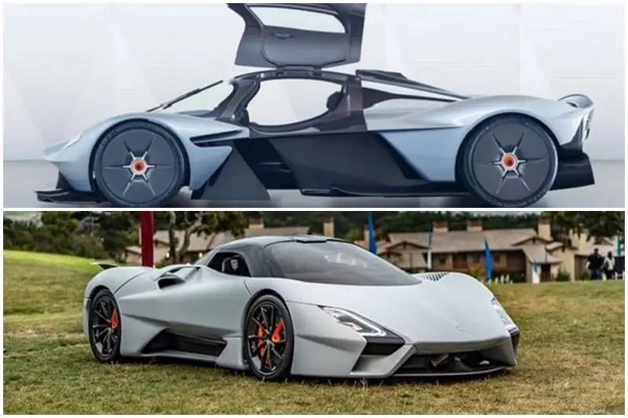
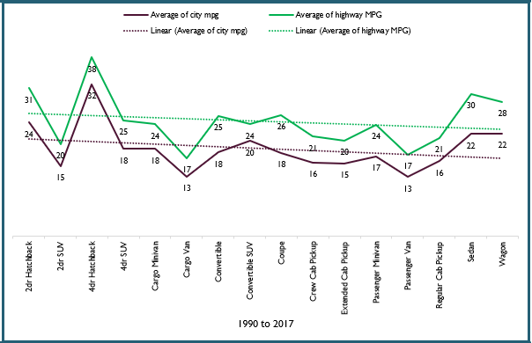
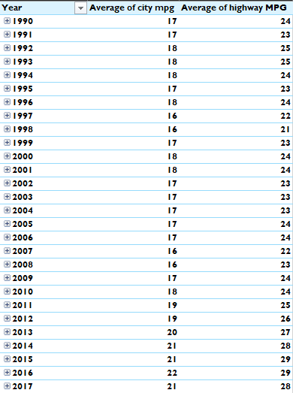
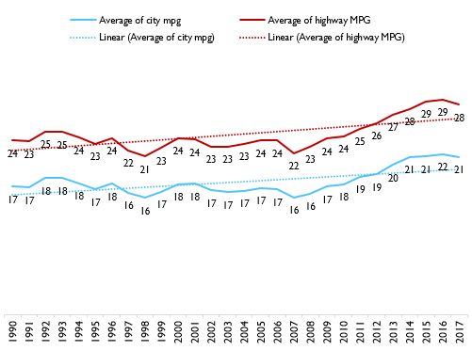
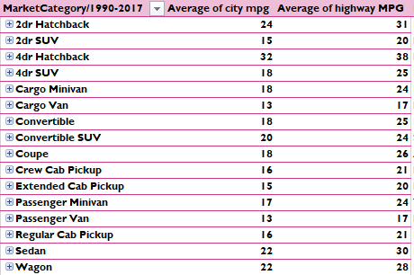
Task4 Line chart showing the trend of fuel efficiency (MPG) from 1990 - 2017 for each vehicle style using Pivot tables
Since 1990 to 2017, Sedans and 4-door hatchbacks tend to be the most fuel-efficient, with averages around 28-38 MPG for city and highway driving.
In contrast, larger vehicles like cargo vans, passenger vans, and SUVs exhibit lower fuel efficiency, with city MPG 13-20 and highway MPG from 17-25.
Over 27 years, the slight upward movement in fuel efficiency indicates gradual improvements in vehicle technology and design, leading to better mileage per gallon across various market categories.

Slide 23
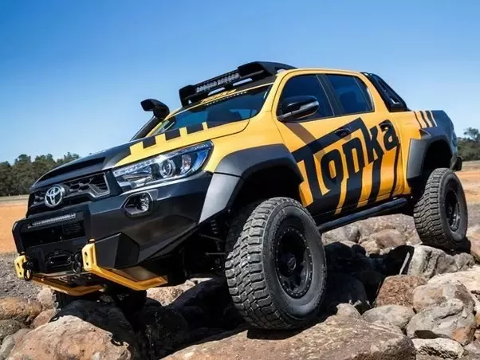
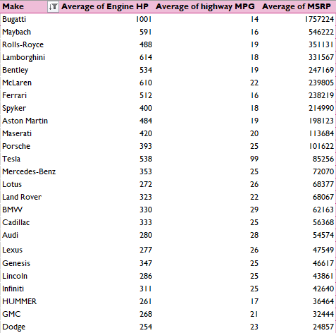
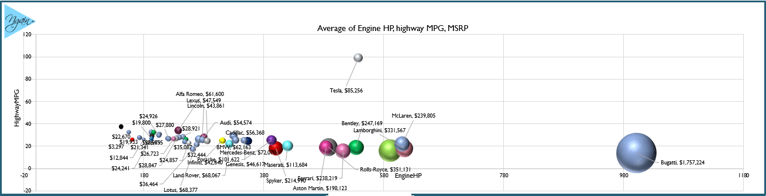
Task5 Bubble chart visualizing relationships between averages of horsepower, MPG, and price across brands using Pivot Tables.
High-performance brands like Bugatti and Lamborghini have the highest horsepower, but they also have lower fuel efficiency (MPG) and significantly higher prices, reflecting their focus on power and luxury.
In contrast, brands like Tesla and Porsche manage to offer high performance with better fuel efficiency, especially Tesla, which has an exceptional highway MPG due to its electric powertrain
Luxury brands like Rolls-Royce and Bentley strike a balance with moderate horsepower and higher prices but slightly better MPG compared to ultra-high-performance brands.
Brands such as BMW, Audi, and Lexus offer more balanced options with relatively lower horsepower, higher MPG, and more affordable prices, appealing to a broader market segment.

Slide 24
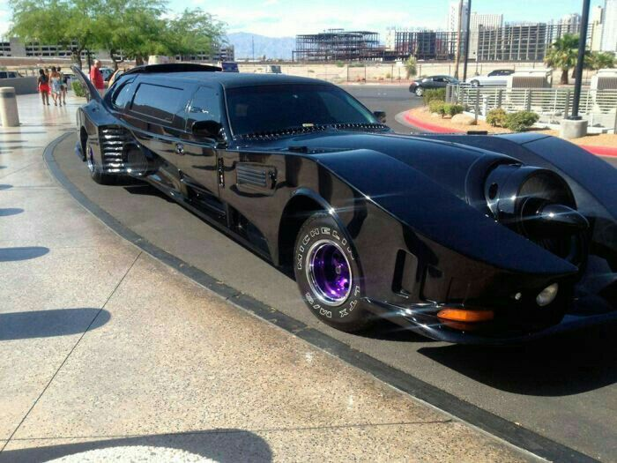
Overall Results and Insights
Future directions could involve expanding the dataset to include more recent models and additional features, or incorporating machine learning techniques to enhance the predictive accuracy of car prices.
Developing a robust model to predict car prices based on variables like engine HP, cylinders, transmission type, and fuel type could help both manufacturers and consumers understand how different features impact price and decision-making.
This approach could provide valuable insights for the automotive industry, particularly in product development, marketing strategies, and pricing tactics.
Analyzing trends over time can reveal how consumer preferences shift and how technological advancements influence car features and pricing.
Moreover, comparing the fuel efficiency of different car types and investigating the relationship between a car's features and its popularity could offer deeper market insights.
Ultimately, predicting car prices based on detailed features and market categories can guide manufacturers in optimizing pricing and product development decisions to balance profitability and consumer satisfaction.
Focusing on the most impactful features in future product development efforts will enhance competitiveness and profitability in a dynamic market.

Slide 25
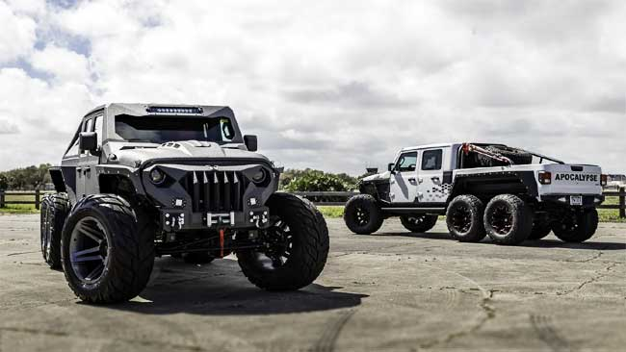
Thanks !

